Slide 1


<Name>
<Date>

Slide 2

Outline
Executive Summary
Introduction
Methodology
Results
Conclusion
Appendix

Slide 3
Executive Summary
Results
Data analytics of this project display the different patterns of SpaceX. This includes analysis on the flights and also locational analysis of the launch locations.
Results display optimum launch locations are near a city by the coast while the predictive model shows all models were equality in classifying successes with exception of the decision tree
Methodologies
-Data Collection through API
-Data Collection with Web Scraping
-Data Wrangling
-Exploratory Data Analysis with SQL
-Exploratory Data Analysis with Data Visualization
-Interactive Visual Analytics with Folium
-Machine Learning Prediction

Slide 4
Introduction
Project background and context
SpaceX launches are expensive costing an advertised 62 million dollars. This project explores the factors that produce effective and successful launches for the company to make better decisions. Some factors that are being assessed include:
What are the factors that determine a launch location?
What are the factors that determine a successful landing?
What models are best in predicting landing success?

Slide 5

Section 1

Slide 6
Methodology
Executive Summary
Data collection methodology:
Data collection was done though a SpaceX API and web scraping tables from Wikepedia.
Perform data wrangling
Data was processed by standardizing features and using one hot encoding to create boolean values
Perform exploratory data analysis (EDA) using visualization and SQL
Perform interactive visual analytics using Folium and Plotly Dash
Perform predictive analysis using classification models
Instigating and tuning models to create most effective predictive classification.

Slide 7
Data Collection
Data from API
The data was extracted from the SpaceX APi using the .get response to pull the needed data
To get the data into Pandas data frame the json.normalize() method was used
The data was filtered by ID to receive the wanted data, and a new dataframe was created
Data from web scraping
BeautifulSoup was used to get the wanted data from wikepeida.
titles were pulled from wikepedia and the table contents were extracted using a loop.
The data was taken as a HTML table then converted into a dataframe for use.

Slide 8
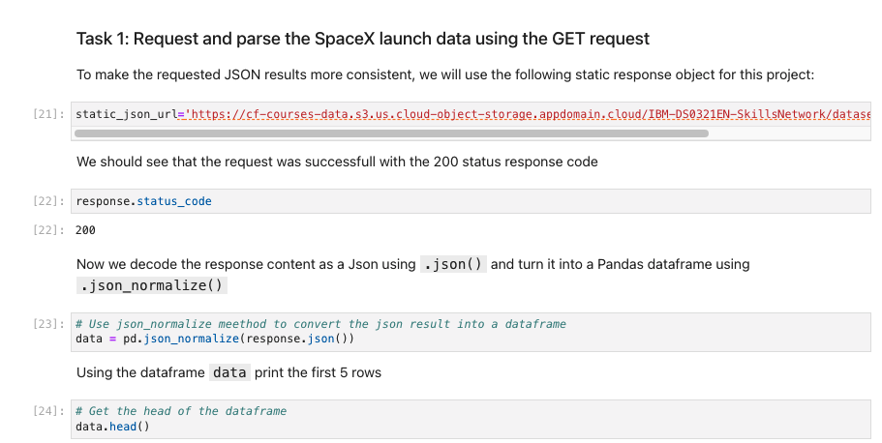
Data Collection – SpaceX API
The SpaceX API collection was cleaned so and added to a new dataframe for use. A screenshot of the command is shown.
The link to the notebook is:
https://github.com/ethanle2000/IBM-Final-Project/blob/282bb14fc18f6e3aa81dbd24bb33e3f012d5f7ad/jupyter-labs-spacex-data-collection-api%20(1).ipynb

Slide 9
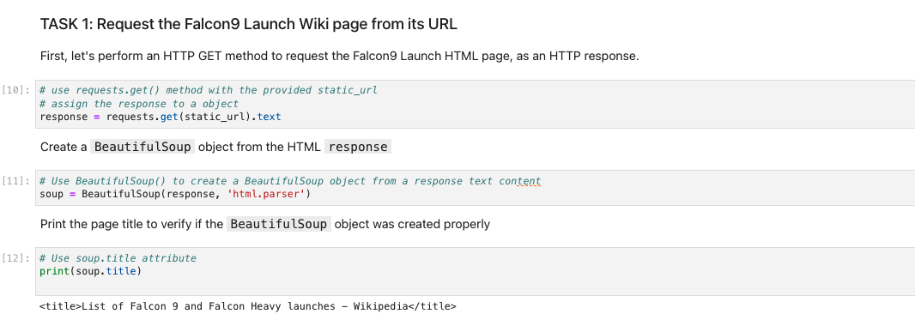
Data Collection - Scraping
The web scraping process mainly consisted of pulling the data needed and placing it into a new data frame that can be used.
The link to the notebook is: https://github.com/ethanle2000/IBM-Final-Project/blob/282bb14fc18f6e3aa81dbd24bb33e3f012d5f7ad/jupyter-labs-webscraping.ipynb

Slide 10
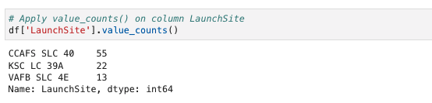

Data Wrangling
Data wrangling consisted of the following steps:
Calculating the values of launches from each launch site
Calculating the value of launches that are in each orbit
Creating an outcome label for the landings - 1 for success and 0 for failure
extracting the new dataframe with the outcome column into a csv
The link to the notebook is:
https://github.com/ethanle2000/IBM-Final-Project/blob/282bb14fc18f6e3aa81dbd24bb33e3f012d5f7ad/labs-jupyter-spacex-Data%20wrangling.ipynb
Visualization of the different orbits

Slide 11
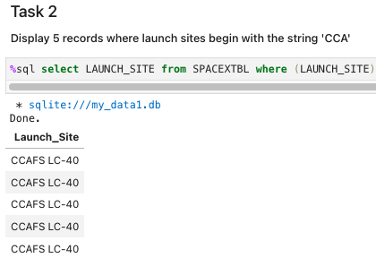
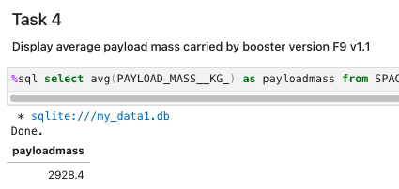
EDA with SQL
Using the SQL, the SpaceX data was filtered to find data of flights with specific criteria. The data gave us more insight to launch data. Some examples are shown to the right.
The link to the notebook is:
https://github.com/ethanle2000/IBM-Final-Project/blob/282bb14fc18f6e3aa81dbd24bb33e3f012d5f7ad/jupyter-labs-eda-sql-coursera_sqllite.ipynb

Slide 12
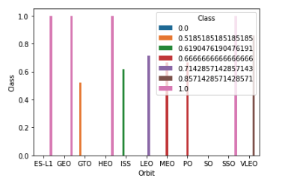
EDA with Data Visualization
Data visualization was used to obtain patterns that can used to observe trends in success rates. plots were created using the seaborn package.
The link to the notebook is:
https://github.com/ethanle2000/IBM-Final-Project/blob/282bb14fc18f6e3aa81dbd24bb33e3f012d5f7ad/jupyter-labs-eda-dataviz.ipynb

Slide 13
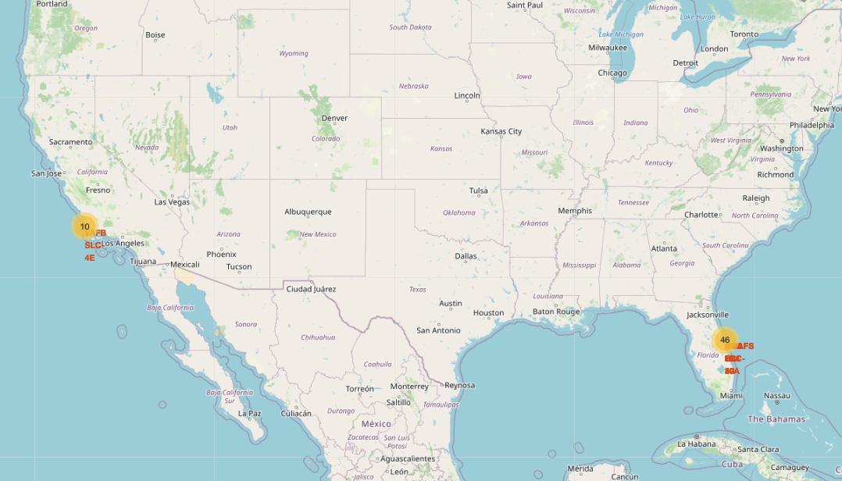
Build an Interactive Map with Folium
The interactive map made with folium was built to display the locations of the launch sites. The maps also produced proximity to railways, highways, coastlines, and cities to help analyze what creates and effective launch location.
The link to the notebook is:
https://github.com/ethanle2000/IBM-Final-Project/blob/282bb14fc18f6e3aa81dbd24bb33e3f012d5f7ad/lab_jupyter_launch_site_location.ipynb

Slide 14
Build a Dashboard with Plotly Dash
An interactive dashboard was built using Plotly dash
the dashboard included:
a pie chart of successes
Payload mass range
scatter plot of Outcome vs Payload Mass
The dashboard is controlled with a drop down menu to show each of the separate sites

Slide 15
Predictive Analysis (Classification)
Classification was done using different predictive models of SKlearn package. The ones used in the project were:
Logistic Regression
Support Vector Machine
Decision Tree
K Nearest Neighbors
The data on these models was 80% training set and 20% held out for the testing set. For each of these models, it was tuned using a a GridSearch to find the parameters that maximized accuracy at a 10 fold cross-validation.

Slide 16
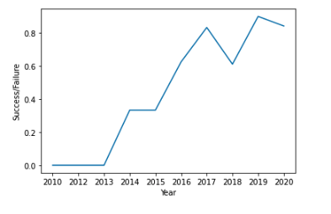
Results
The exploratory analysis showed that success rates varied across different orbits and that payload mass had little effect on success across different orbits.
The main take away from the exploratory data showed that success rate had the strongest correlation with the year, with more recent flights being more successful.
This is displayed by the graph on the right
For the predictive model the model that showed that all models except the decision tree performed with 83.33% accuracy on the test set.

Slide 17

Section 2

Slide 18
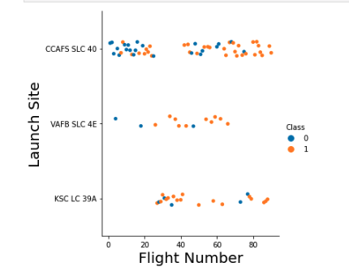
Flight Number vs. Launch Site
The graph between flight number and launch site shows that there are a higher percentage of successes with flights from VAFB and KSC then from CCAFS.
Additionally we also see the later flight numbers tend to be more successful.

Slide 19
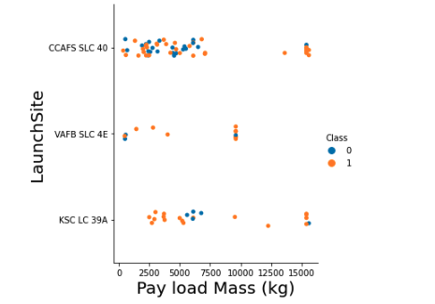
Payload vs. Launch Site
In this graph we dont see much strong correlation between the payload mass and the launch site success. This shows that there are other factors that have a higher predictive power.
This graph does show that VAFB site does not do heavier load launches.

Slide 20
Success Rate vs. Orbit Type
From the plot we see that •ES-L1, GEO, HEO, SSO, VLEO had the most success rate.
However there is no trenc that shows a strong correlation between orbit and success.

Slide 21
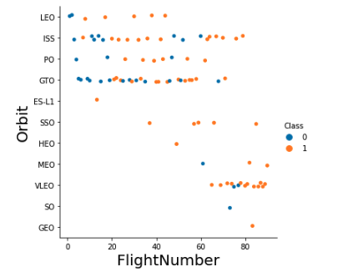
Flight Number vs. Orbit Type
This graph shows a strong correlation showing a trend of newer flights going to different orbits that older ones.
This graph also shows how certain orbits such as SSO and VLEO have higher success rates. This could be correlated to distance or some other unaccounted factor.

Slide 22
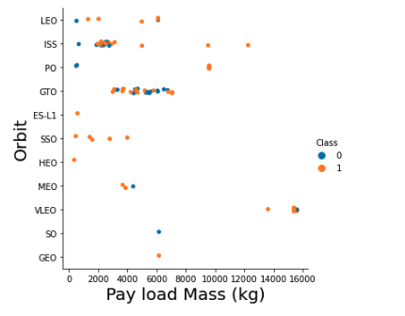
Payload vs. Orbit Type
Given this graph we see no strong correlation to the classification of success.
However, we see some correlation between orbits and payloads with specific orbits such as SSO having lighter loads and VLEO having heavier ones.

Slide 23
Launch Success Yearly Trend
This graph shows the strongest correlation.This shows a strong correlation that more recent launches have higher success.

Slide 24
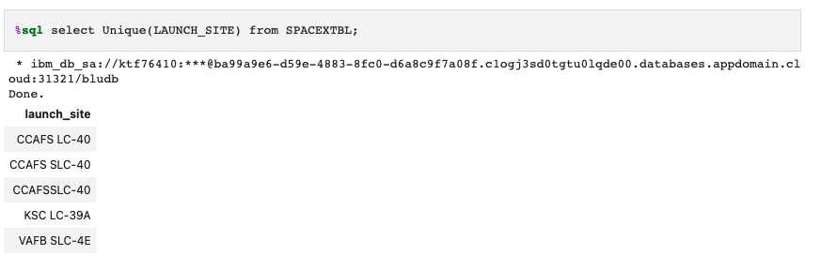
All Launch Site Names
This query selects all of the unique names from the table.

Slide 25
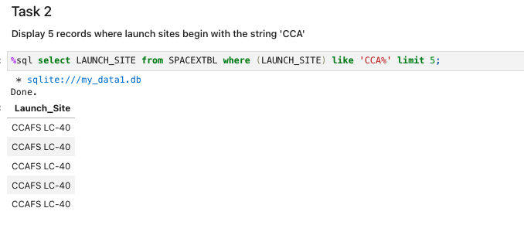
Launch Site Names Begin with 'CCA'
The query gets all launch sites where CCA is included

Slide 26
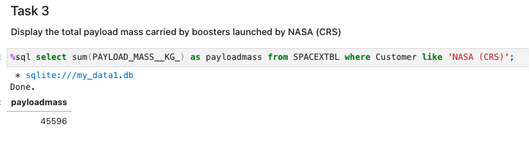
Total Payload Mass
The query calculated the total payload mass by boosters NASA (CRS)

Slide 27
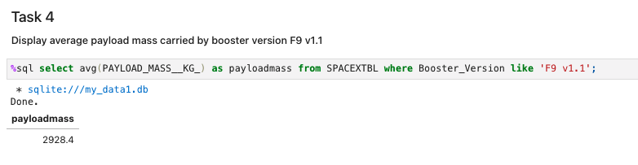
Average Payload Mass by F9 v1.1
the average payload mass carried by booster version F9 v1.1

Slide 28
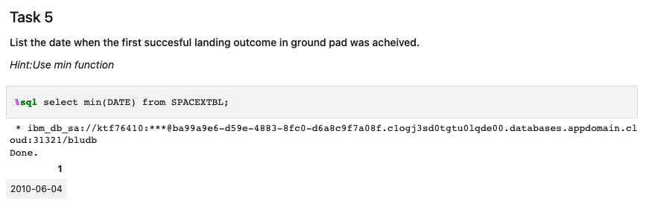
First Successful Ground Landing Date
The date of the first successful landing outcome on ground pad

Slide 29
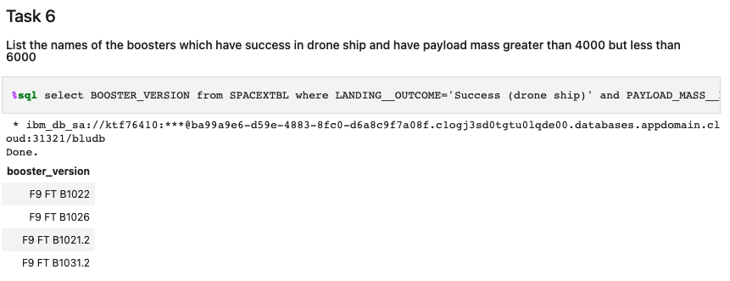
Successful Drone Ship Landing with Payload between 4000 and 6000
The names of boosters which have successfully landed on drone ship and had payload mass greater than 4000 but less than 6000

Slide 30
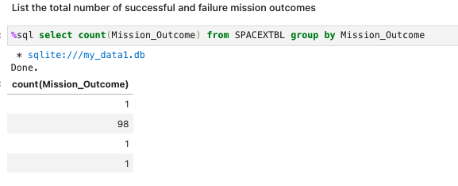
Total Number of Successful and Failure Mission Outcomes
The total number of successful and failure mission outcomes

Slide 31
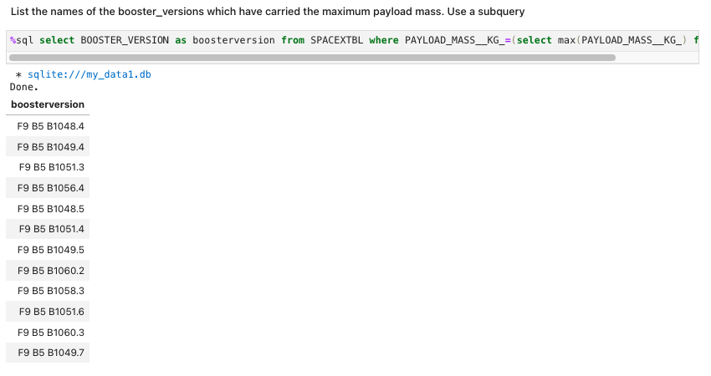
Boosters Carried Maximum Payload
The names of the booster which have carried the maximum payload mass

Slide 32
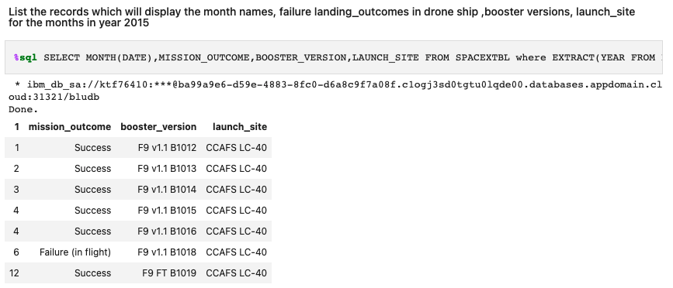
2015 Launch Records
List the failed landing_outcomes in drone ship, their booster versions, and launch site names for in year 2015

Slide 33
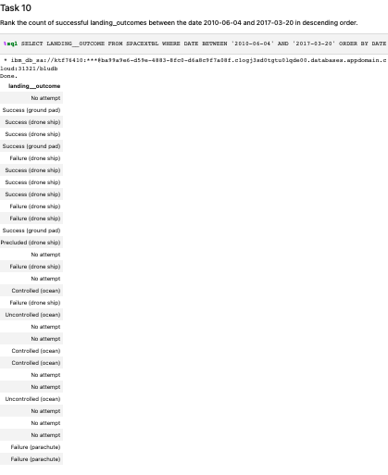
Rank Landing Outcomes Between 2010-06-04 and 2017-03-20
Rank the count of landing outcomes (such as Failure (drone ship) or Success (ground pad)) between the date 2010-06-04 and 2017-03-20, in descending order

Slide 34

Section 3

Slide 35
Location of Space X launch sites
SpaceX Launch Locations are only in the United States in Florida and California

Slide 36
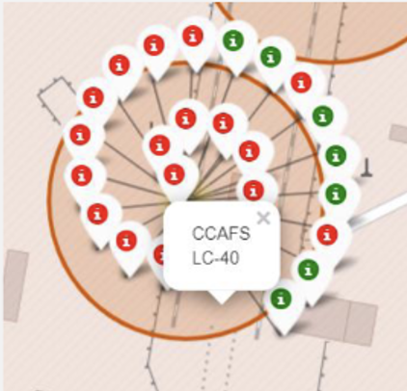
Sucessful vs Unsucessful Launches
Green markers show successful launches while red ones show unsuccessful ones

Slide 37

Factors to launch site locations

Slide 38

Section 4

Slide 39
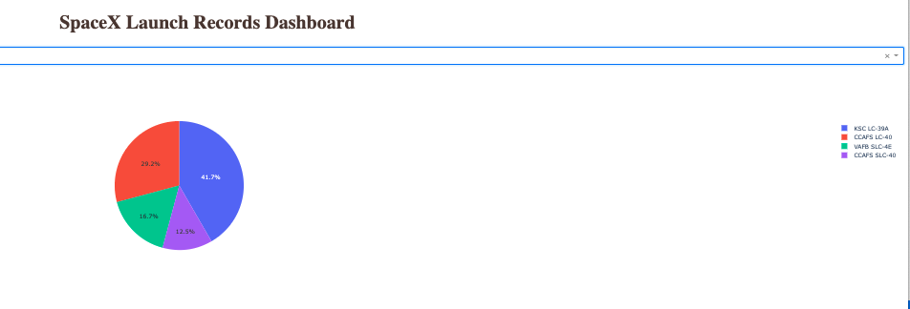
Total Success Launch Pie Chart
From the pie chart we see that KSC LC-39a has the most successful launches.

Slide 40
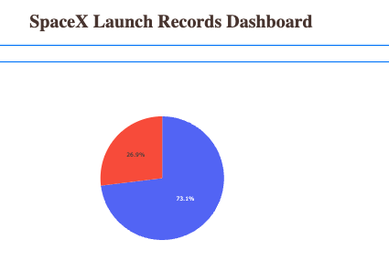
filtered pie chart for CCAFS LC-40 Launch site
Success Rate for CCAFS LC-40 Launch site

Slide 41

<Dashboard Screenshot 3>

Slide 42

Section 5

Slide 43

Classification Accuracy
The Model that had the highest classification accuracy on the training set was the Decision Tree

Slide 44

Confusion Matrix
The confusion matrix of the classifier shows that it made 15/18 correct predictions with 3 false positive labels that did not land in reality

Slide 45
Conclusions
Success rates is most heavily correlated with the recency of the launches. The most recent launches are more likely to be successful.
Certain orbits are easier to accomplish and display higher rates of success even with variation in payload weight
KSC LC-39A is the most successful launch site
Decision Trees did best in training accuracy, however it is not a reflection of test accuracy as other models had higher score on test set.

Slide 46
Appendix
Include any relevant assets like Python code snippets, SQL queries, charts, Notebook outputs, or data sets that you may have created during this project

Slide 47


